Slide 1
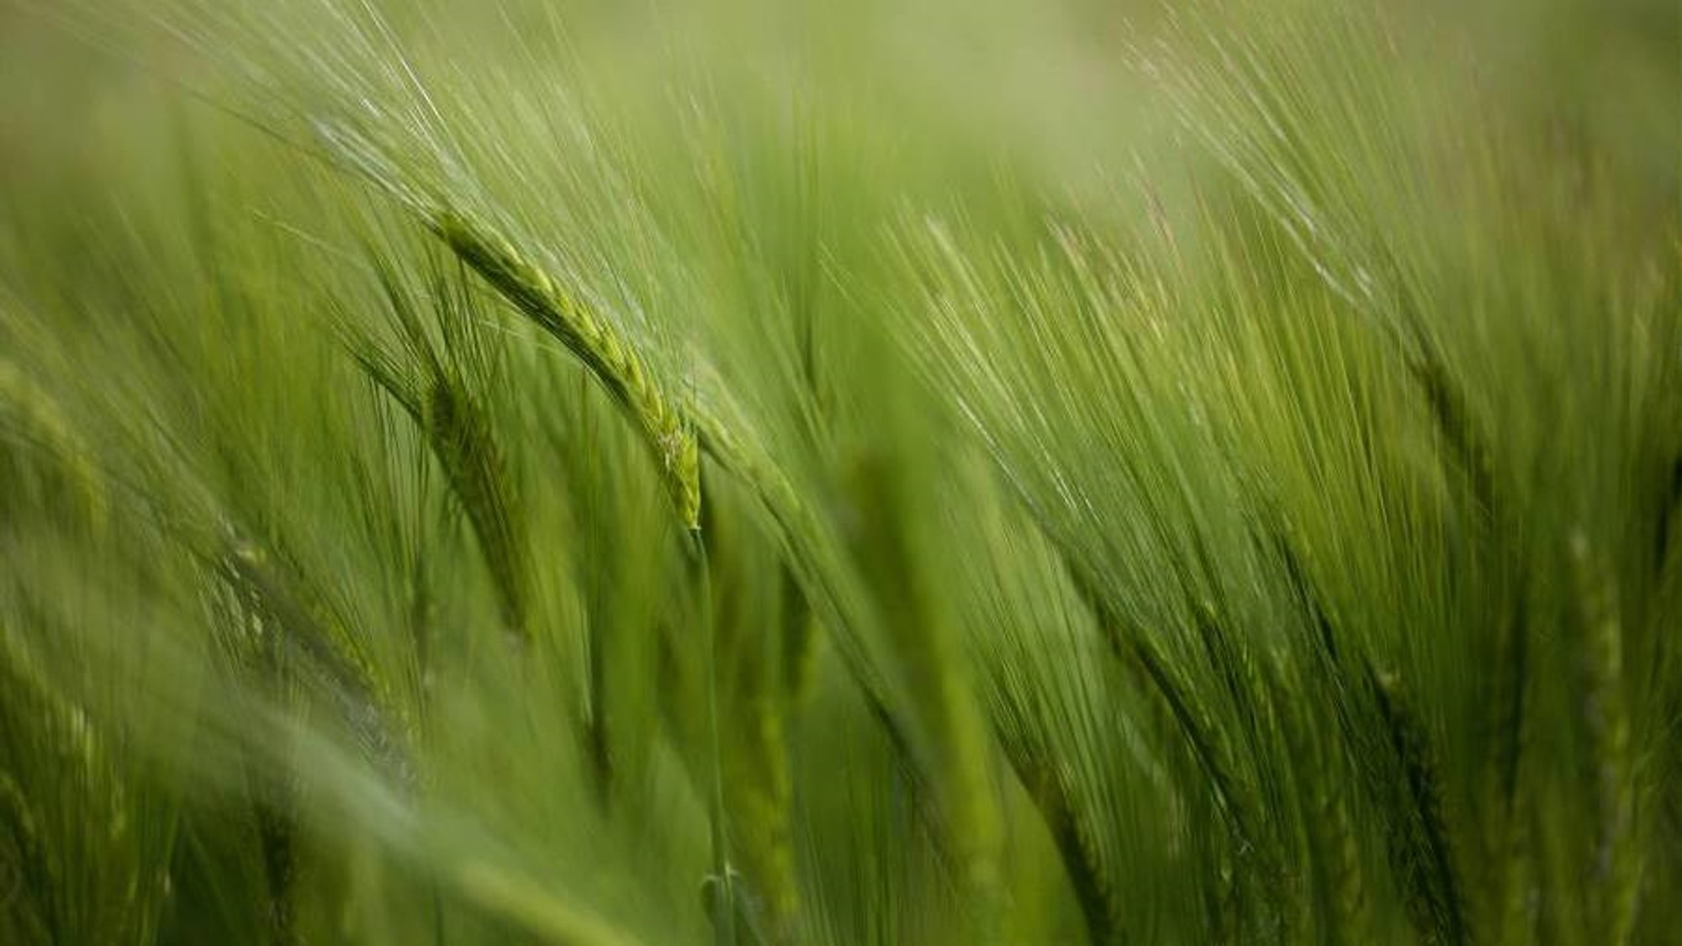

OneAgroBharat Crop Yield Prediction using ML & Cloud Deployment

Slide 2

AGENDA
Introduction & Objectives
Problem Statement
Dataset Overview
Exploratory Data Analysis
Data Preprocessing
Model Building & Evaluation
API & Cloud Deployment
Key Insights & Conclusion
Future Scope
Q&A

Slide 3
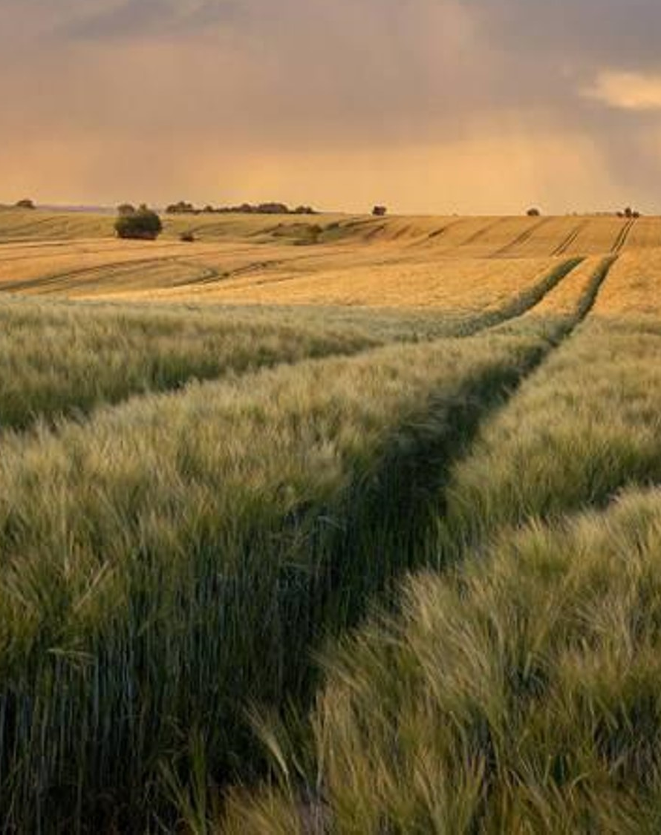
Introduction
OneAgroBharat is a machine learning-powered solution designed to predict crop yield using key agricultural factors such as:
Soil Composition (Area)
Rainfall and Temperature
Pesticide Usage
Crop Cultivation History
The project aims to empower farmers, researchers, and policymakers with accurate yield forecasts, enabling data-driven agricultural decisions.
Developed with a vision of “One Nation, One Agro-Tech Solution,” this project reflects India’s contribution to global agri-innovation, while being rooted in local challenges and practices.

Slide 4

Unpredictable crop yields due to changing climate patterns, inconsistent rainfall, soil degradation, and unmonitored pesticide usage pose a major challenge to global agriculture.
Traditional methods of yield forecasting often lack accuracy, are region-specific, and fail to adapt to rapidly changing environmental conditions.
Farmers and policymakers struggle to make timely, informed decisions due to the lack of accessible, real-time, and data-driven tools.
There is a growing need for a scalable, intelligent system that can analyze historical agricultural data and environmental factors to accurately predict crop yields.
PROBLEM STATEMENT

Slide 5
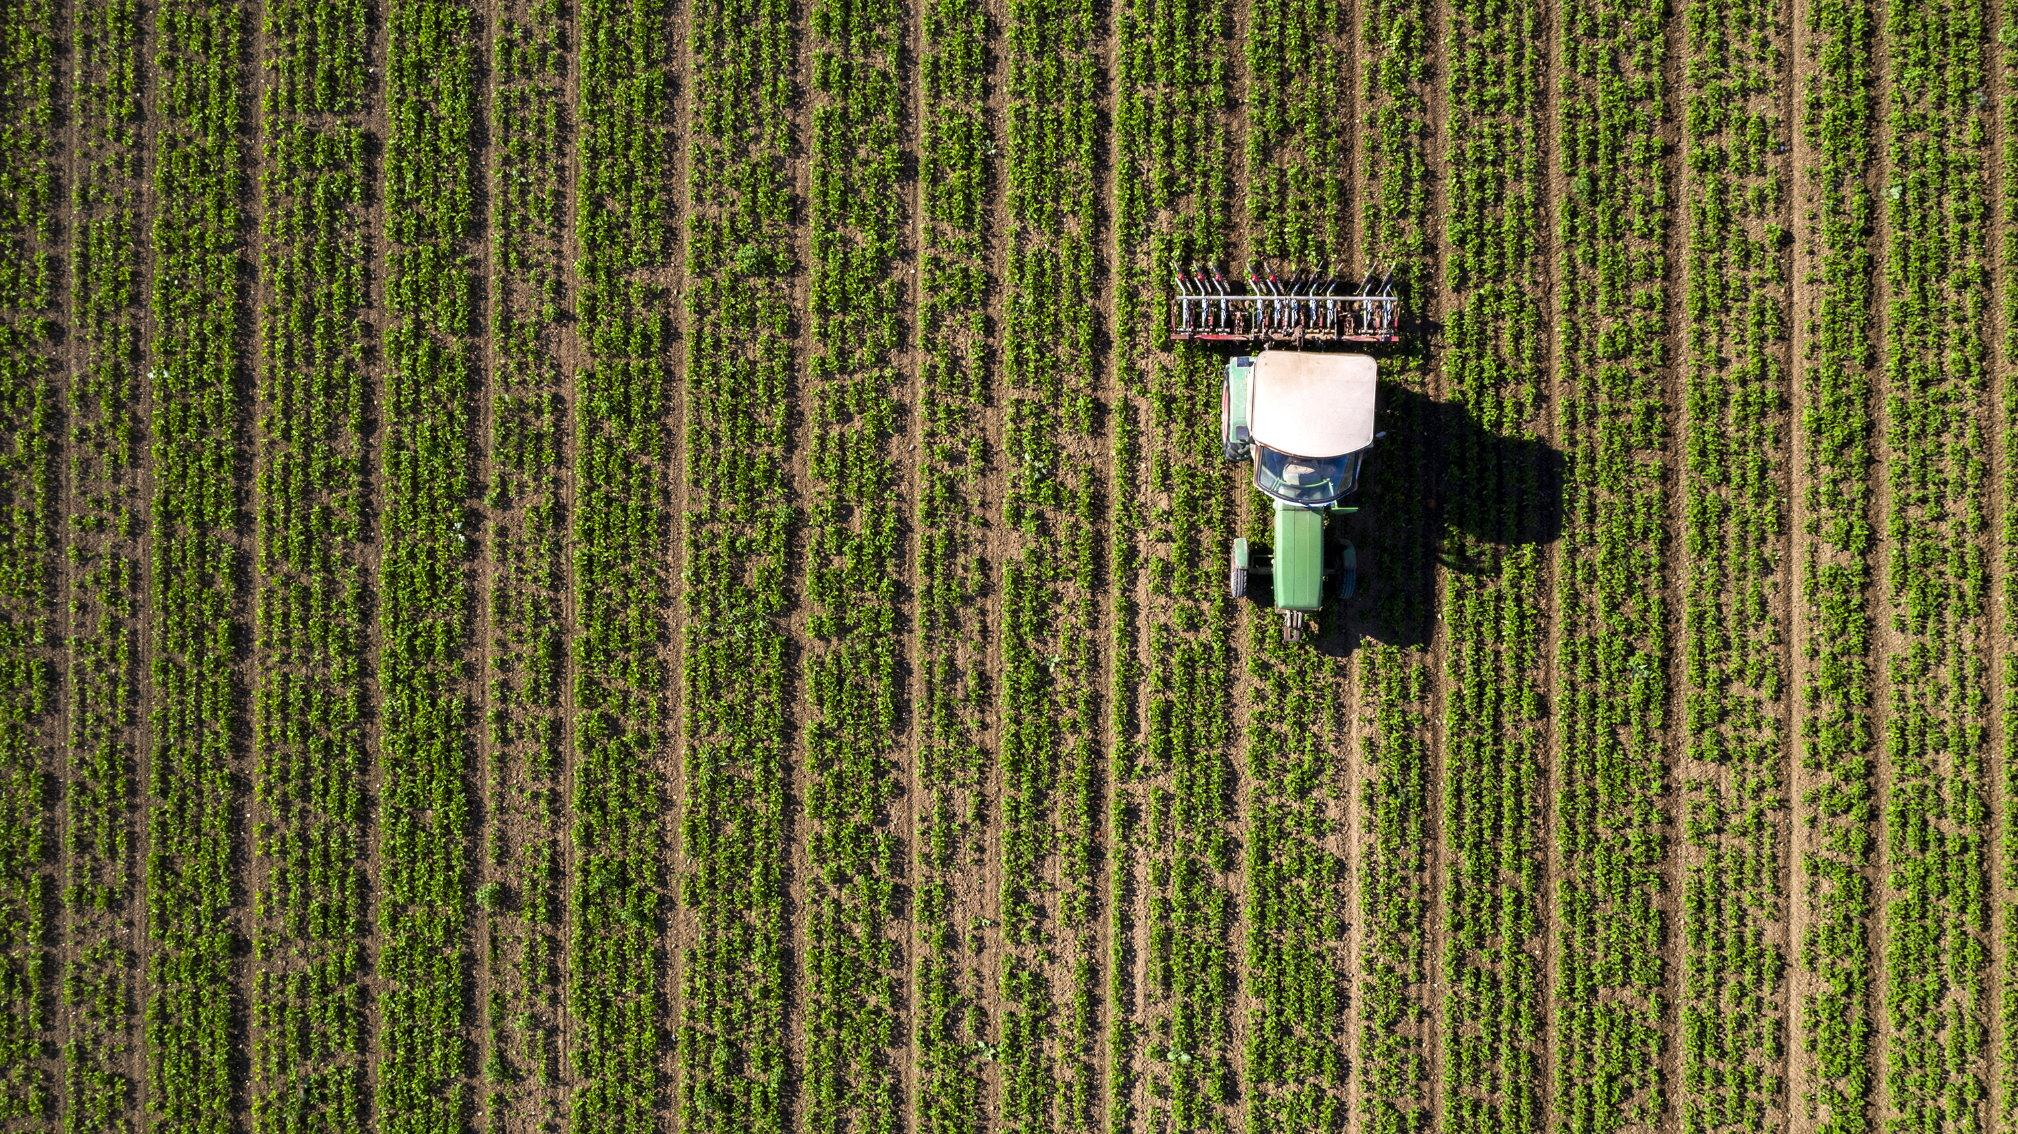
The dataset was sourced from Kaggle, containing global agricultural and climate data. It includes information from over 100 countries across multiple years and various crops.
Key features include:
Crop yield (target)
Rainfall, temperature, pesticide usage
Area, crop type, country, and year
The dataset was cleaned, outliers removed, and features encoded and scaled for model training.
DATASET OVERVIEW

Slide 6
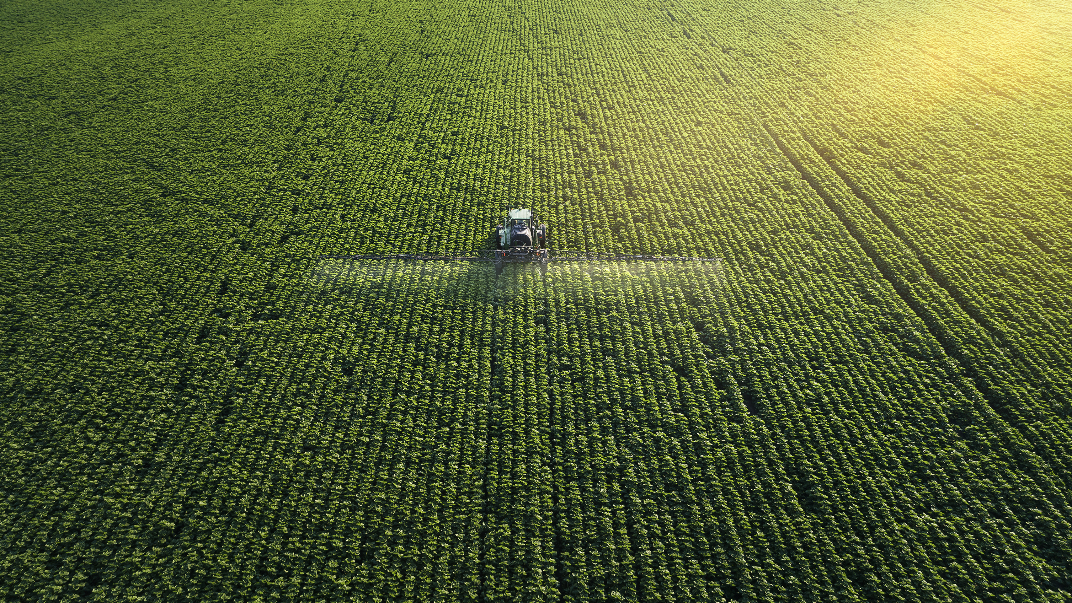
DATASET OVERVIEW
FEATURE | DESCRIPTION
Area | Country or Regin of Crop Cultivation
Item | Crop type (Maize, Rice, Wheat, etc.)
Year | Year of the recorded observation
hg/ha_yield | Crop yield in hectograms per hectare
average_rain_fall_mm_per_year | Average annual rainfall (mm)
pesticides_tonnes | Annual pesticide usage (tonnes)
avg_temp | Average annual temperature(°C)

Slide 7
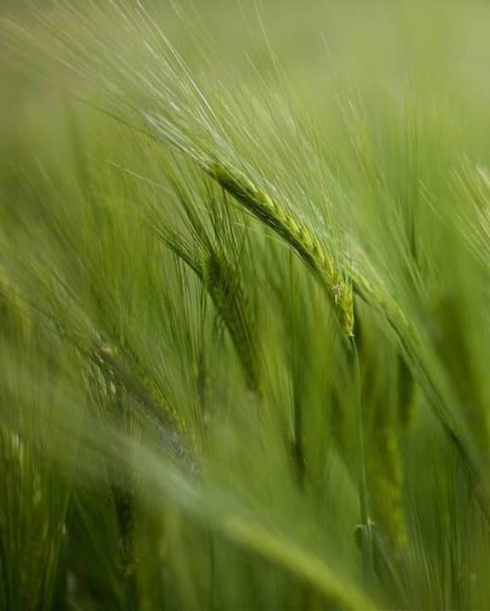
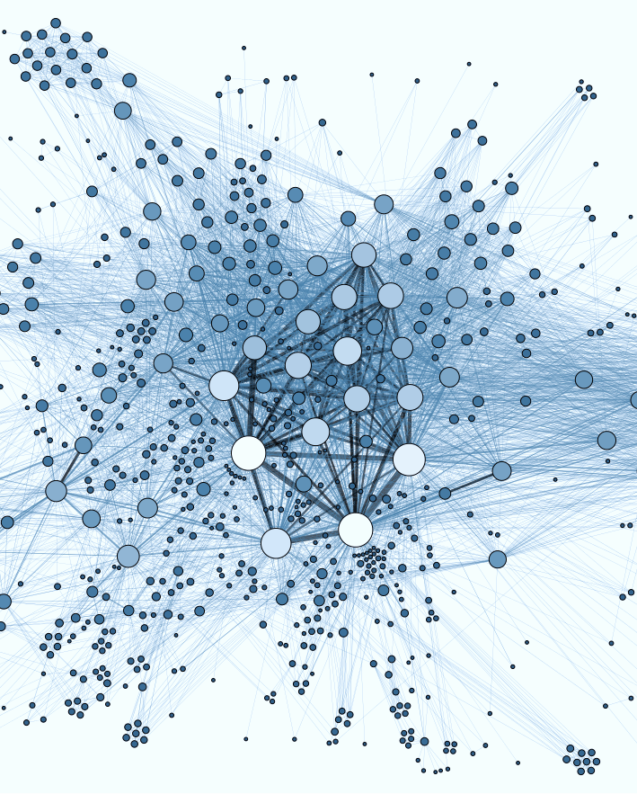
Exploratory data analysis (EDA) Exploratory Data Analysis was performed to understand feature distributions, detect anomalies, and uncover hidden patterns in the data. We used boxplots, histograms, scatterplots, and a correlation heatmap to visualize relationships between variables like rainfall, temperature, pesticide usage, and crop yield. Outliers were detected—especially in rainfall and pesticide usage—and were handled using the interquartile range (IQR) method to prevent skewed model learning.
EXPLORATORY DATA ANALYSIS

Slide 8

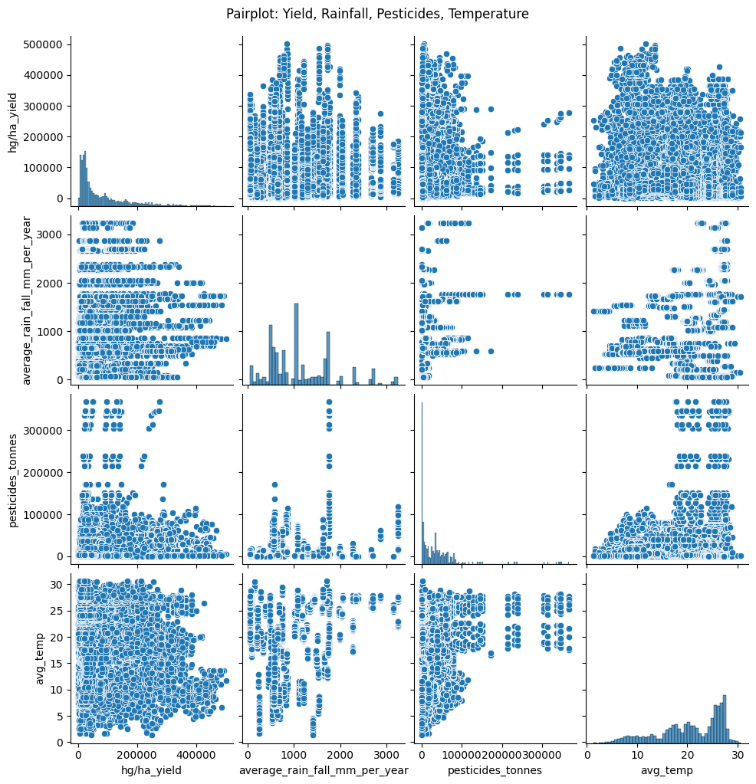
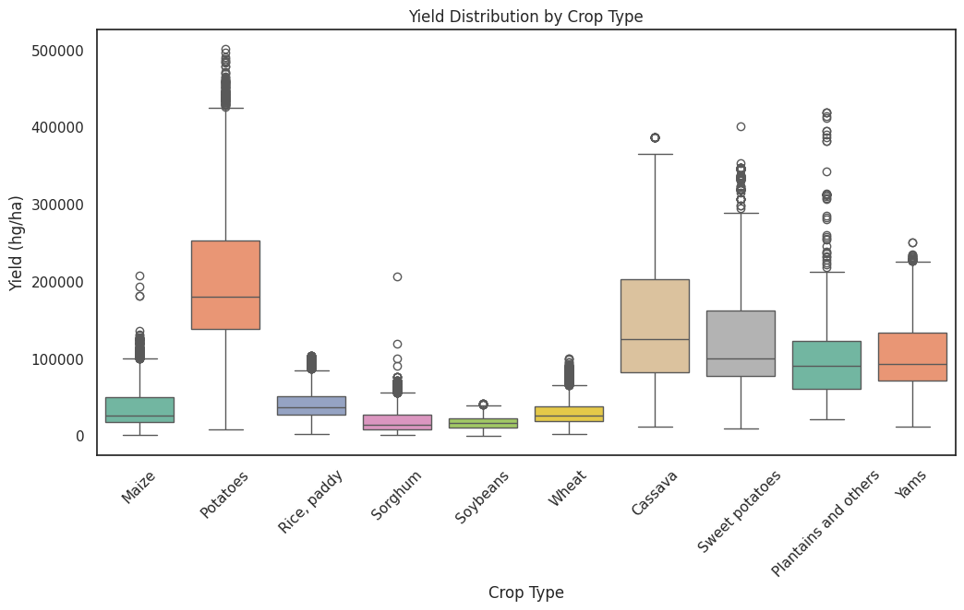
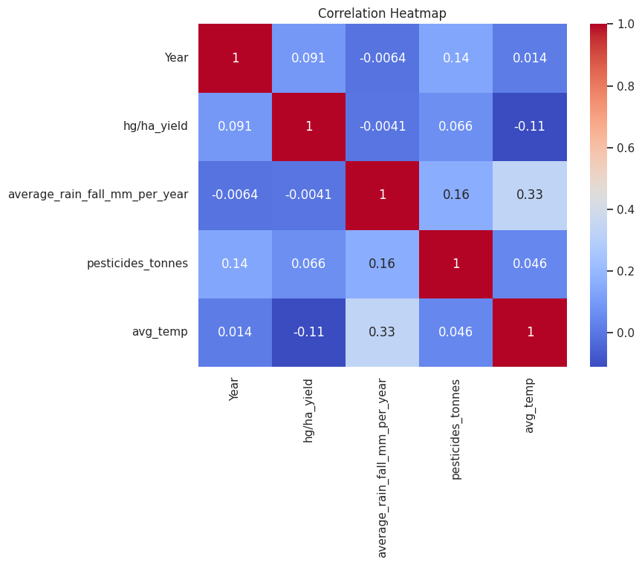
EDA DIAGRAMS

Slide 9
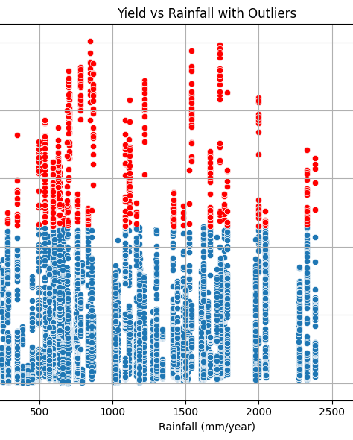
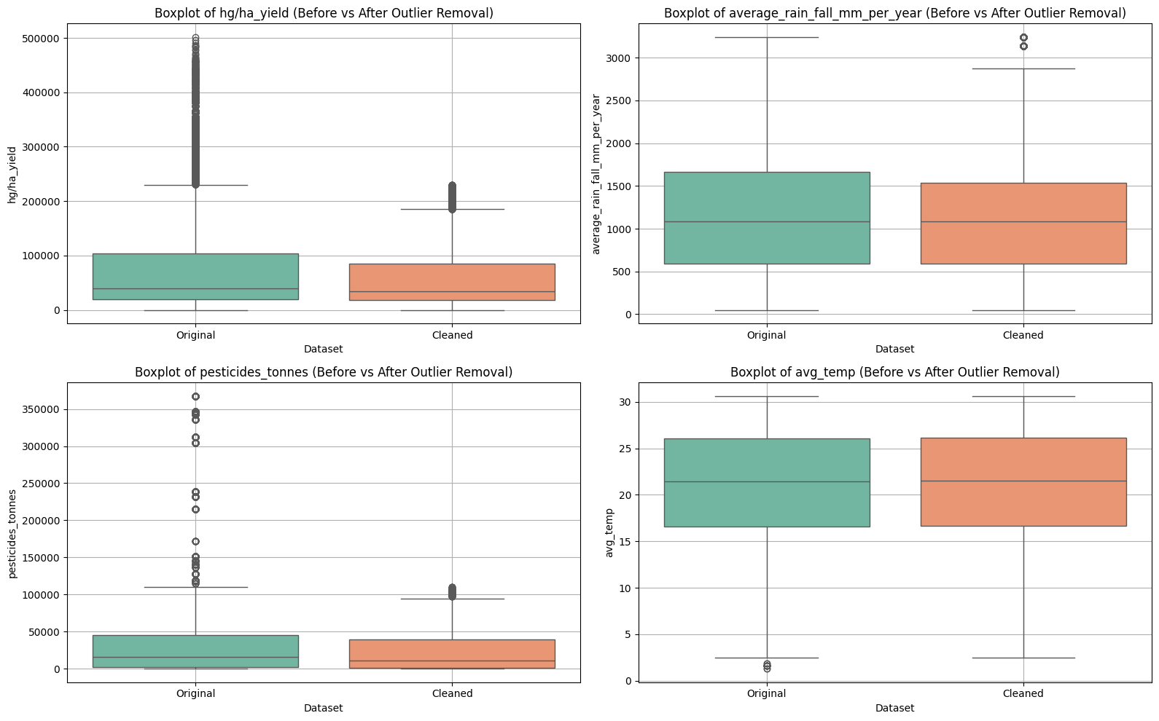
Diagrams Continued….

Slide 10
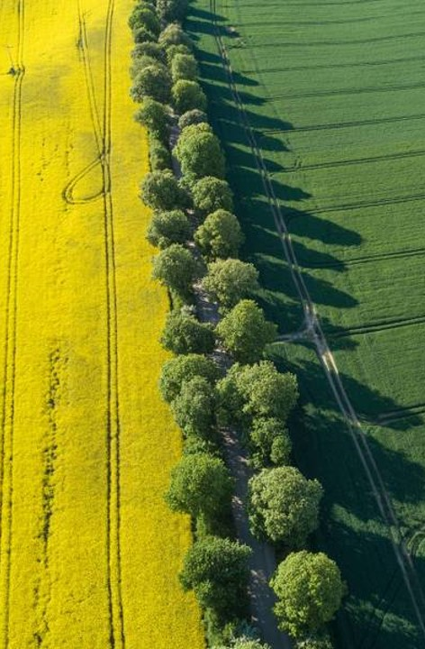
Data Preprocessing
To ensure clean and consistent input for machine learning models, we applied the following preprocessing steps:
1. Handling Missing Values
Used mean/median imputation for numerical features
Forward fill or mode for categorical data
2. Outlier Detection & Removal
Detected using boxplots
Removed using Interquartile Range (IQR) method
3. Encoding Categorical Features
Applied One-Hot Encoding and Dummy Variables
Converted categorical columns like Crop, Country, Year to numeric format
4. Feature Scaling
Used StandardScaler to normalize feature values
Ensures fair comparison across features
5. Multicollinearity Check
Calculated VIF (Variance Inflation Factor)
Removed or retained features based on VIF analysis

Slide 11

Model Evaluation & Results
We evaluated each model using standard regression metrics to assess accuracy and performance:
Evaluation Metrics:
MAE (Mean Absolute Error)
MSE (Mean Squared Error)
RMSE (Root Mean Squared Error)
R² Score (Coefficient of Determination)
Model | R² Score
Random Forest | 0.9845
K-Nearest Neighbors | 0.9823
Decision Tree | 0.9766
Linear Regression | 0.7486
Ridge Regression | 0.7485
Lasso Regression | 0.7485
Top Performing Model:
Random Forest Regressor
-Highest R² Score (~0.98)
-Lowest Error Rates
-Excellent at capturing non-linear relationships in data

Slide 12

ANALYTICAL DASHBOARD

Slide 13

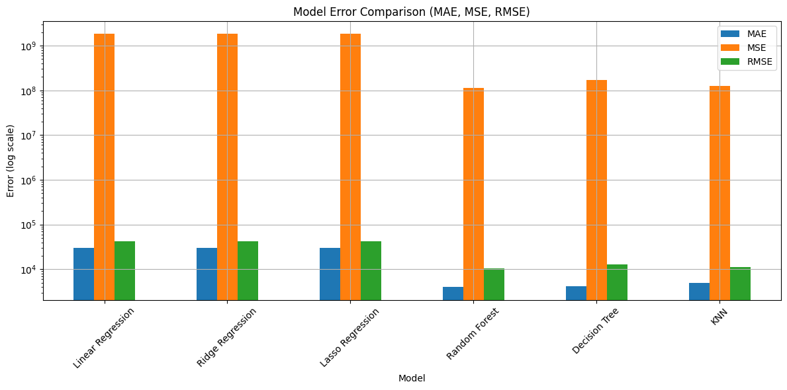
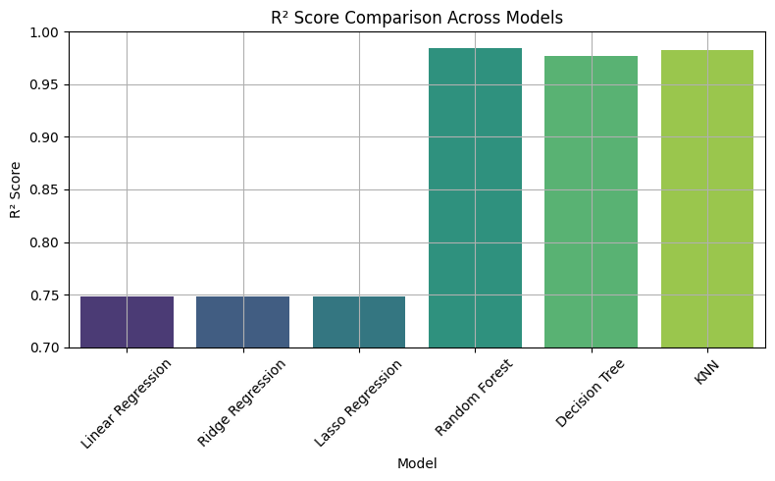
Model Comparision (Error and R² Score)

Slide 14




API & Cloud Deployment
Flask API Development
Built a lightweight Flask API to serve ML model predictions
Accepts input (e.g., rainfall, temperature, area) via JSON
Returns real-time crop yield predictions
Containerization with Docker
Dockerized the application to ensure:
Portability
Consistent deployment across environments
Faster scaling and testing
Deployment on AWS EC2
Hosted the entire application on an AWS EC2 instance
Ensured 24x7 availability, scalability, and secure access
Used Git for version control and collaborative updates
This Photo by Unknown Author is licensed under CC BY
This Photo by Unknown Author is licensed under CC BY-SA

Slide 15
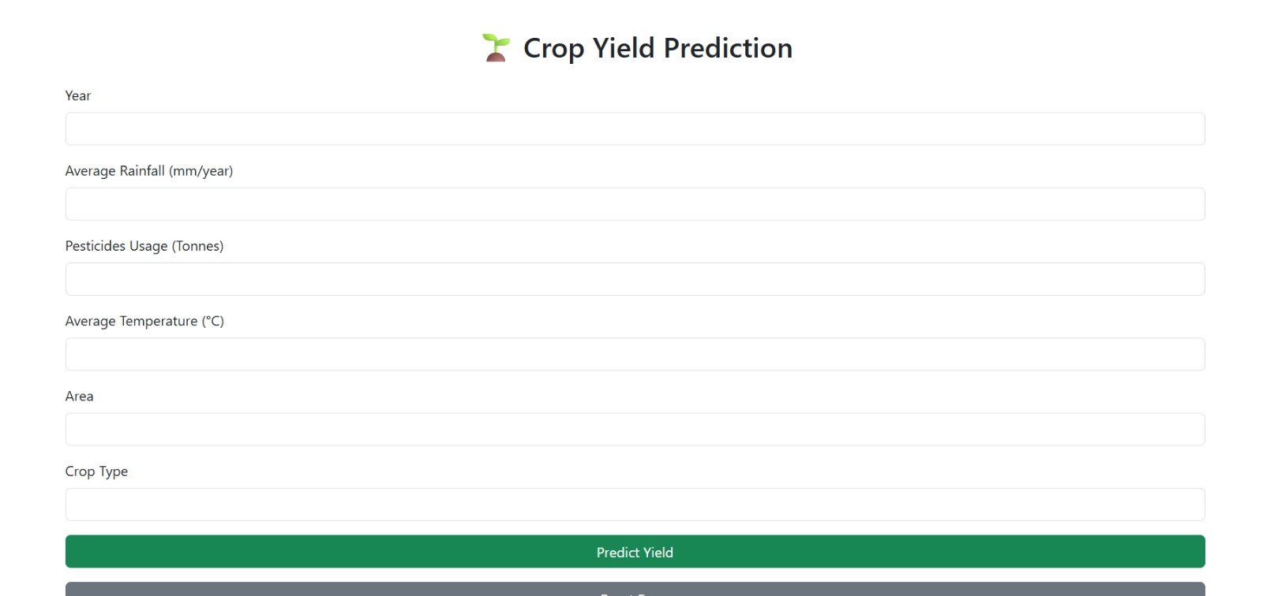
FRONTEND USING PYTHON + FLASK API + HTML + CSS

Slide 16

Key Insights
Random Forest emerged as the most accurate and robust model for crop yield prediction (R² ~ 0.98)
Rainfall, pesticide usage, and temperature showed strong correlation with crop yield
Outlier detection and feature scaling significantly improved model performance
Geographical and temporal diversity in the dataset highlighted the need for adaptable models

Slide 17
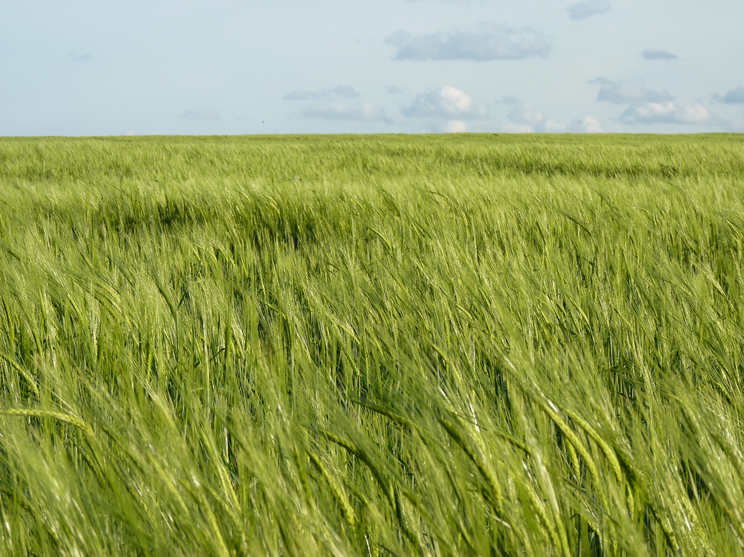
CONCLUSION
OneAgroBharat successfully delivers a machine learning-powered solution for crop yield forecasting
The system enables data-driven agricultural decision-making
With real-time predictions and cloud deployment, it offers a scalable platform for global impact
This project showcases the potential of combining ML, API development, and cloud infrastructure in the AgriTech domain

Slide 18
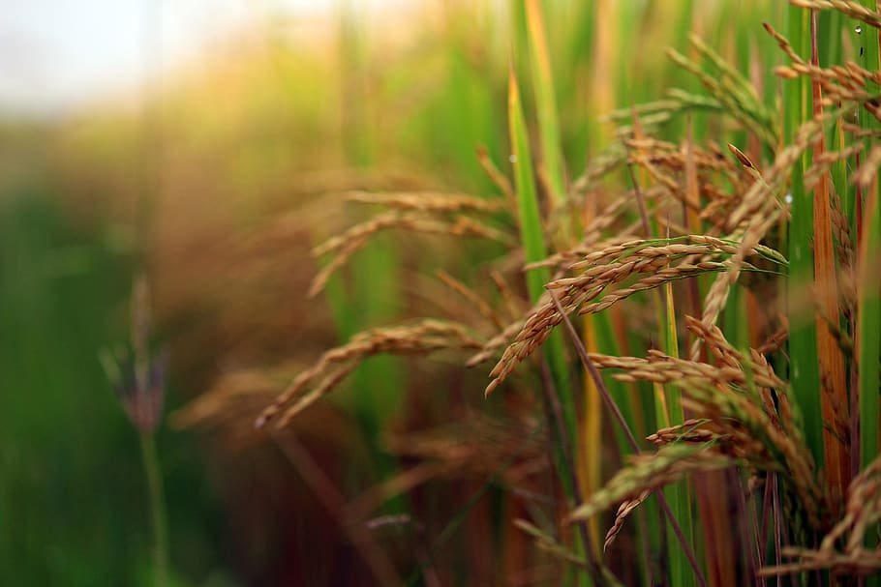

Future Scope
1. Real-Time Weather Integration
Connect with live weather APIs to enable dynamic and real-time yield predictions based on current conditions.
2. Crop Recommendation System
Suggest the most suitable crop based on soil, climate, and historical performance using classification models.
3. Integration with Satellite & IoT Data
Incorporate remote sensing and sensor-based data (e.g., NDVI, soil moisture) for deeper insights and accuracy.
4. Multi-Language Support
Include regional languages to enhance usability for diverse farmer communities across India.
5. Government & Policy Integration
Collaborate with agri-departments to support policy planning, subsidies, and risk assessment at scale.

Slide 19



Slide 20

Thank you
Aaradhy Vijaywat (250220525001)
Harsh Tandon (250220525010)
Priyanka kumari (250220525015)

